Slide 1

MERCEDES BENZ WEBSITE ALISHER BEGMATOV

Slide 2
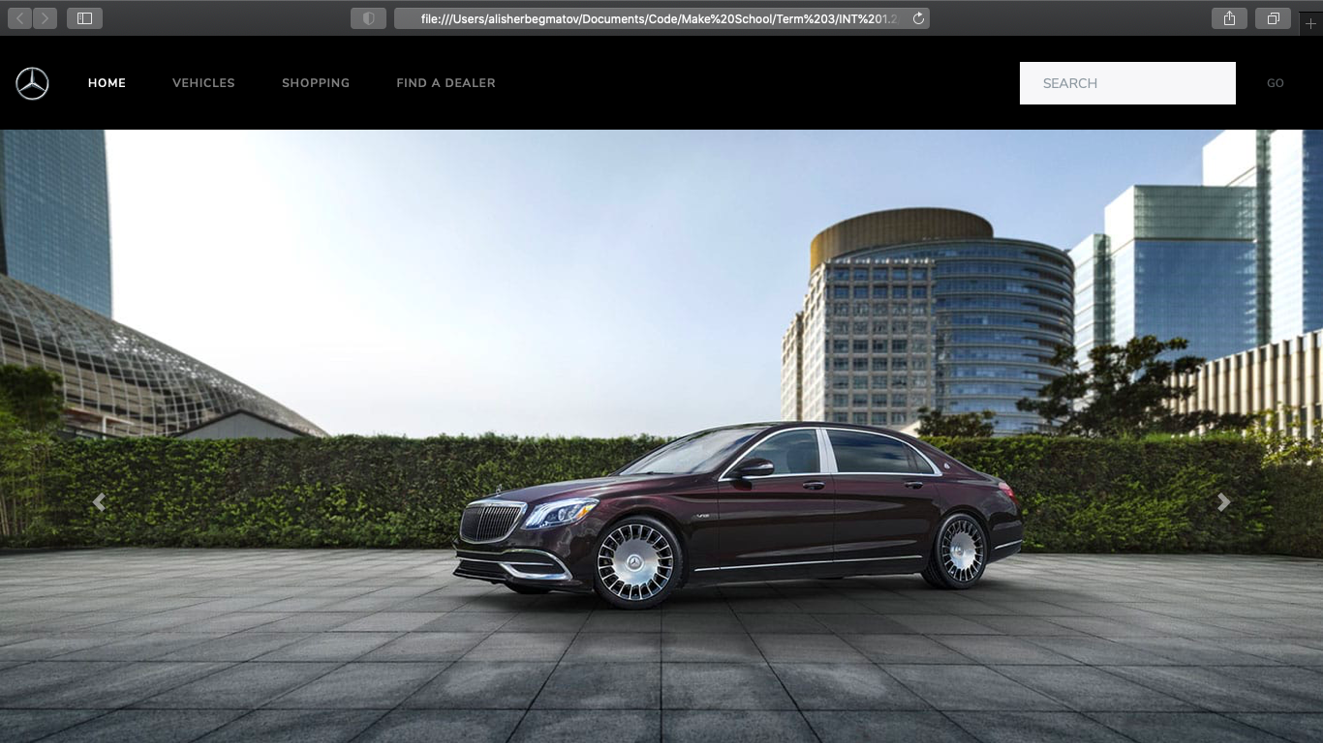

Slide 3
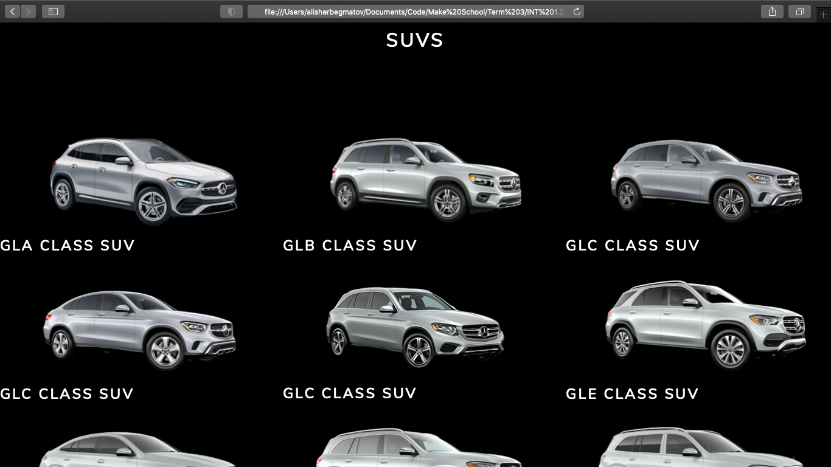

Slide 4
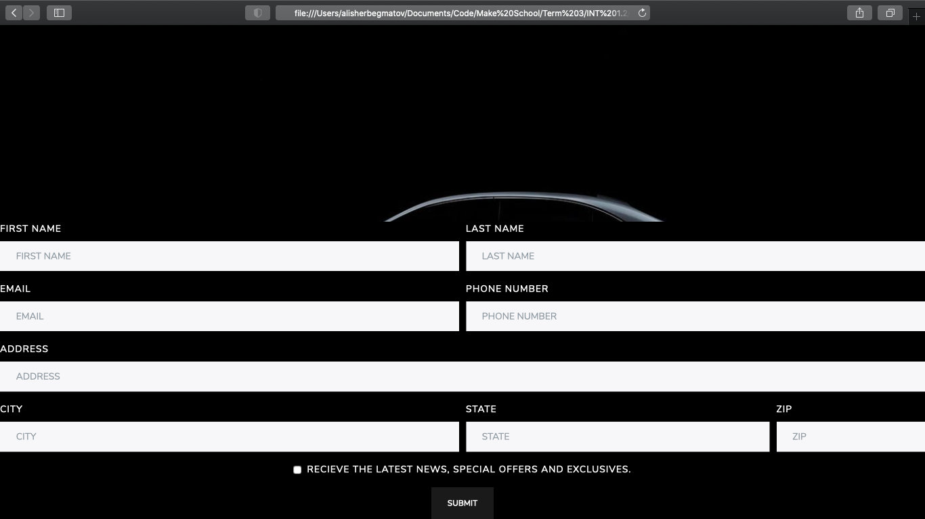

Slide 5
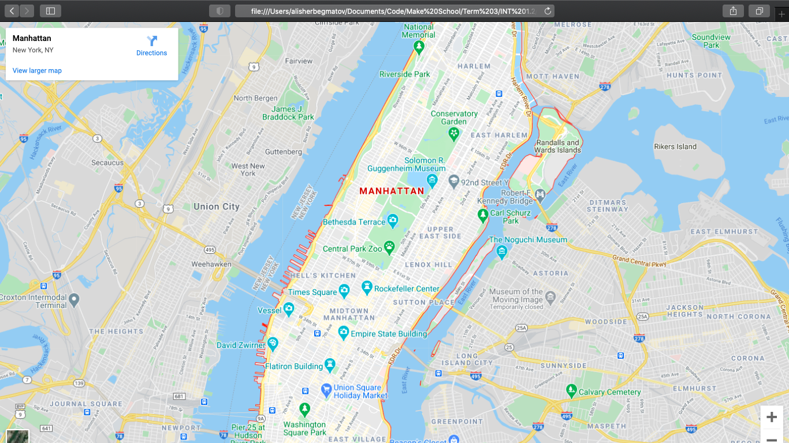

Slide 6
VISIT NOW!
https://alisherbegmatov.github.io/intensive-project/

